Slide 1
CloudWalk Internship Challenge: Data Analysis and Monitoring System
Daniel Campos França – 27/07/2024

Slide 2
CONTENTS
Introduction
Challenge 1: Get Your Hands Dirty
Challenge 2: Solve the Problem
Conclusion and Future Improvements

Slide 3
INTRODUCTION
Purpose of the internship challenge
Overview of the two challenges

Slide 4
Challenge 1 - Get Your Hands Dirty
Objective
Data source
Goal
Analyze hypothetical checkout data
CSV file
Identify anomalous behaviors

Slide 5





Mathematical Methods Used (Challenge 1)
Weighted Mean
Simple Mean
Variance
Standard Deviation
Upper and Lower Limits
$$\frac{\left(avg_{last_{week}}×7\right)+\left(avg_{last_{month}}×30\right)​}{(7+30)}$$
$$\frac{\sum_{i=1}^{n}{xi}}{n}$$
$$\frac{\sum{(x −mean)²}}{n−1}$$
$$\sqrt{variance}$$
Upper limit$=weighted mean+(2∗std_{dev})$
Lower limit$=weighted mean−(2∗std_{dev})$

Slide 6
Analysis Method 1
Explanation of the first analysis method
Use of standard deviation and upper/lower limits
K value and its significance

Slide 7
Analysis Method 2
Explanation of the second analysis method
Identification of anomalies within limits
Comparison with weighted mean

Slide 8
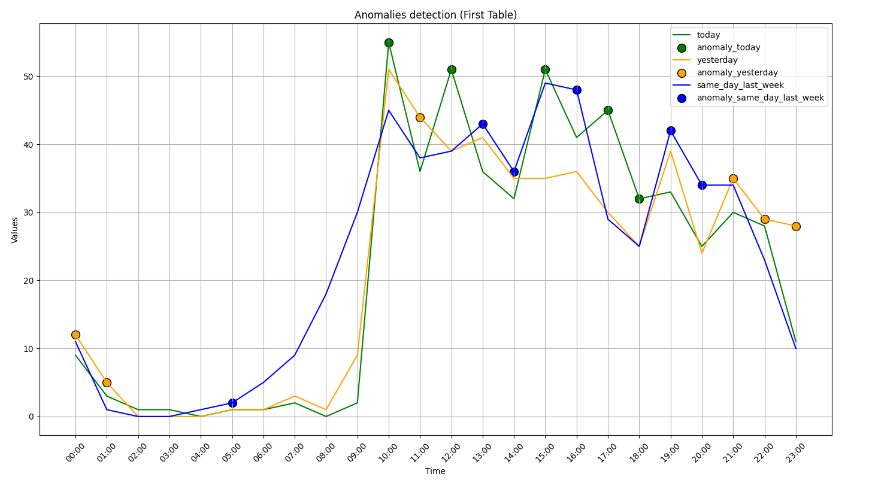
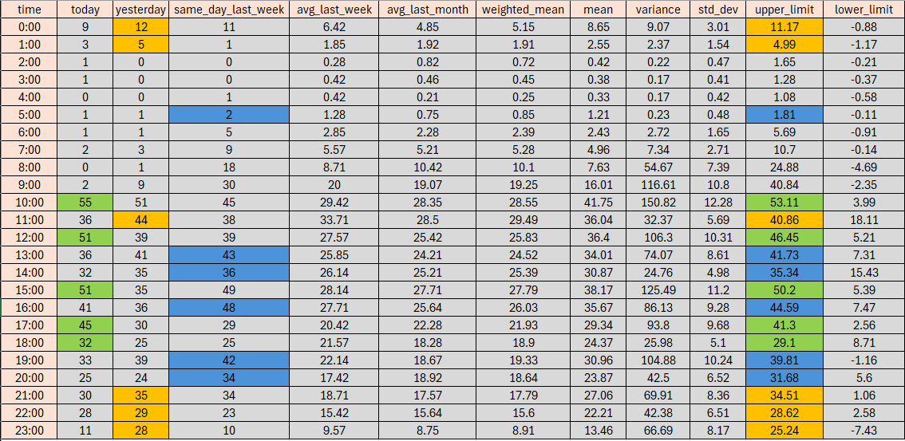
Analysis Method 1- FILE 1

Slide 9
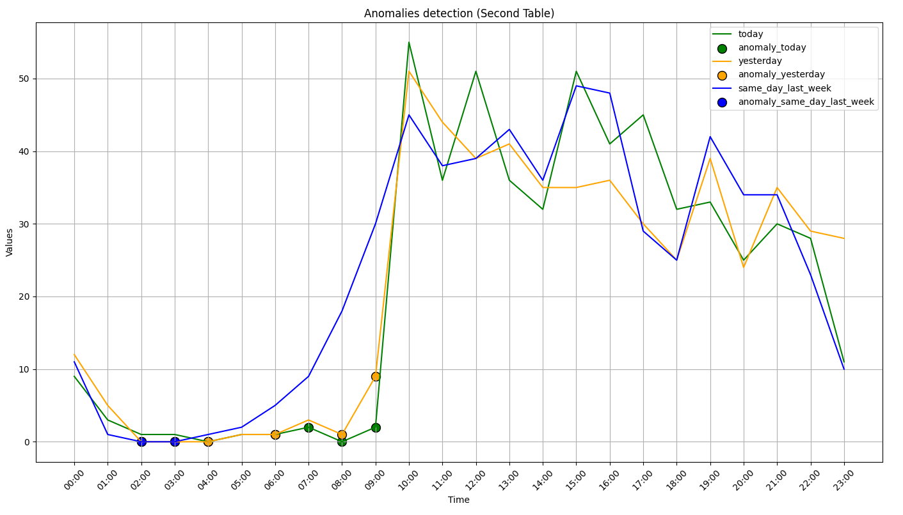
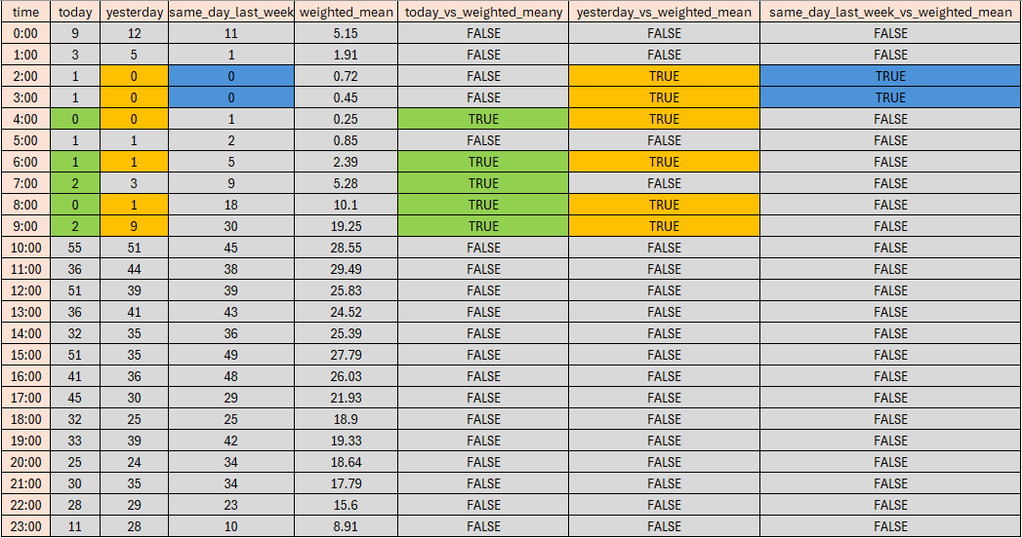
Analysis Method 2 - FILE 1

Slide 10
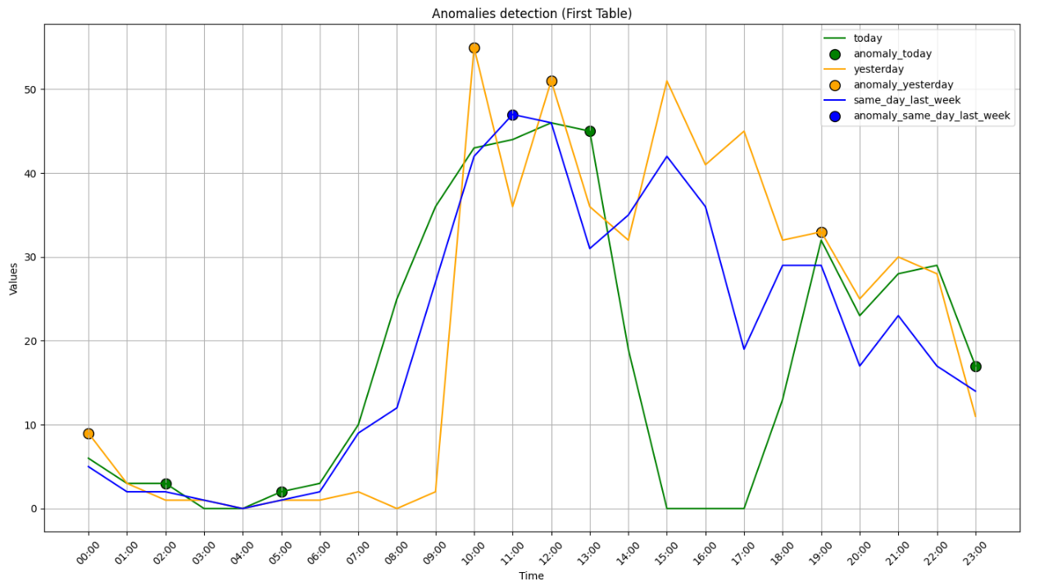
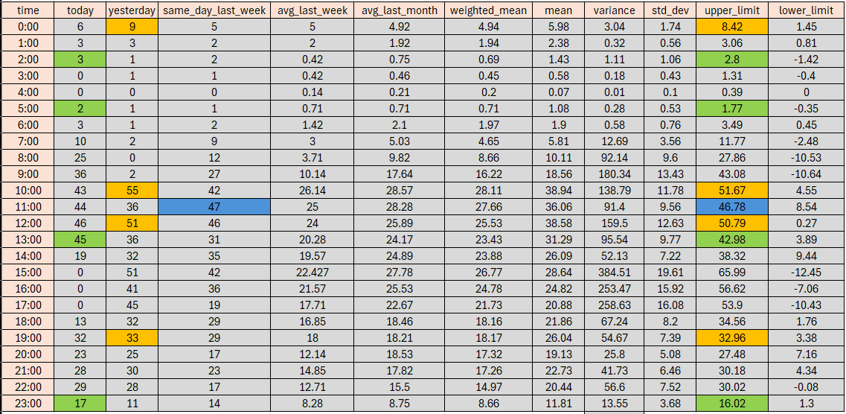
Analysis Method 1 - FILE 2

Slide 11
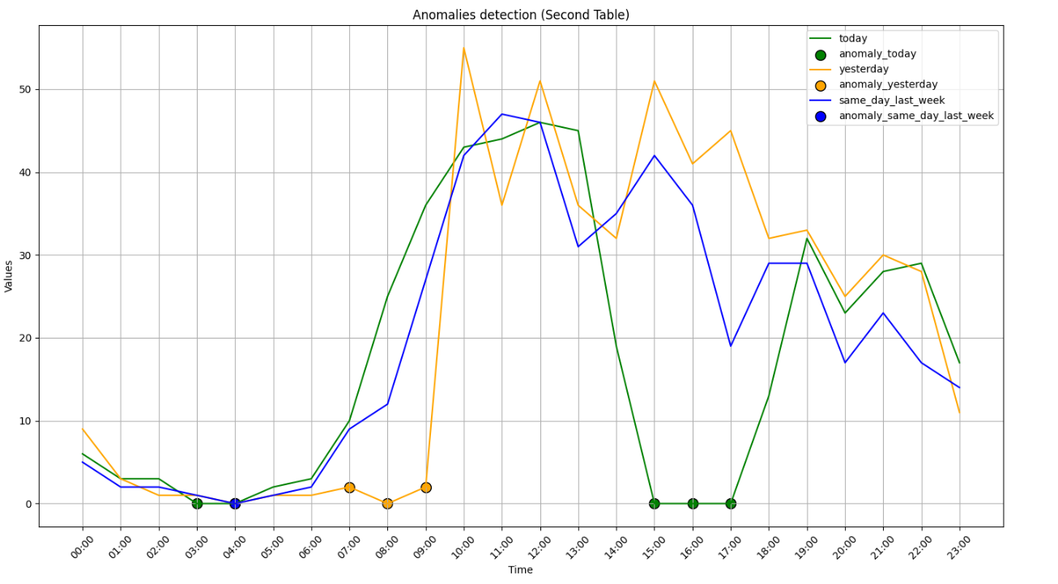
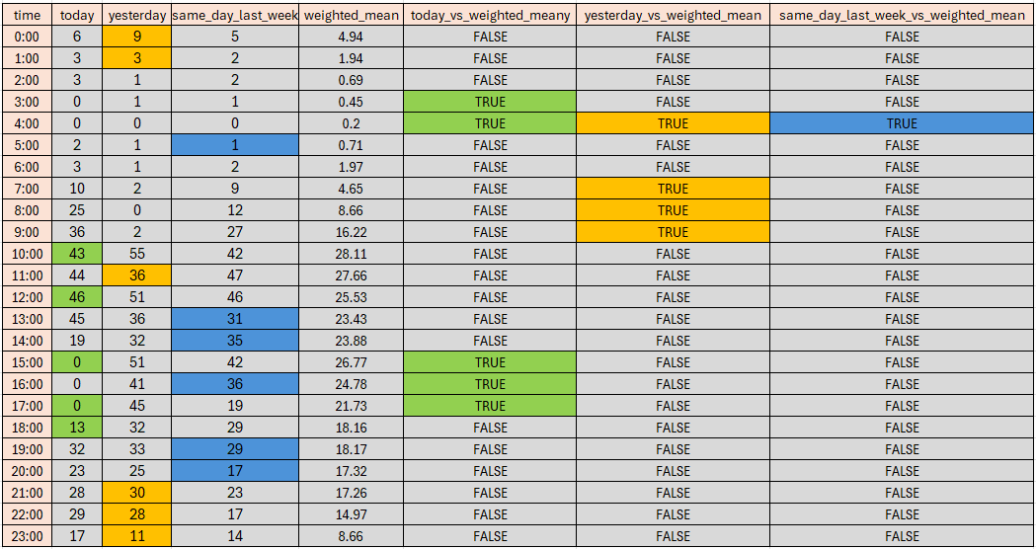
Analysis Method 2 - FILE 2

Slide 12
Insights from Challenge 1
24-hour transaction patterns
Peak hours of operation
Potential fraud indicators

Slide 13
Challenge 2 - Solve the Problem
Objective
Data source
Goal
Implement real-time monitoring system
CSV file
Identify anomalies and generate automatic notifications

Slide 14


Mathematical Methods Used (Challenge 1)
Simple Mean
Standard Deviation
Z-score
$$\frac{\sum_{i=1}^{n}{xi}}{n}$$
$$\sqrt{variance}$$
$$z= \frac{x−μ}{\text{σ}}$$

Slide 15
Analysis Method - Challenge 2
Summing values by status for each hour
Calculation of simple mean for each status
Z-score threshold of 0.7

Slide 16
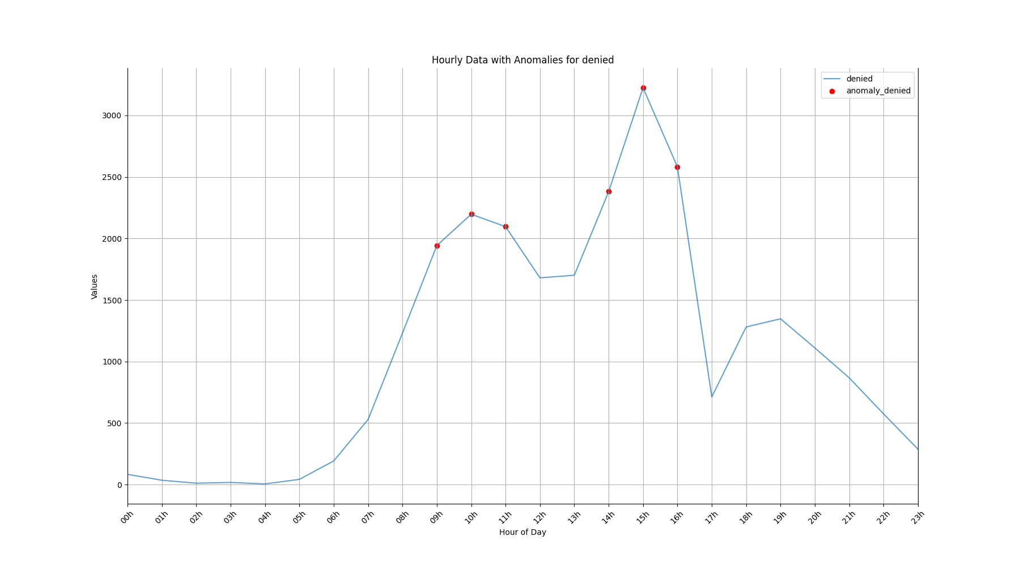
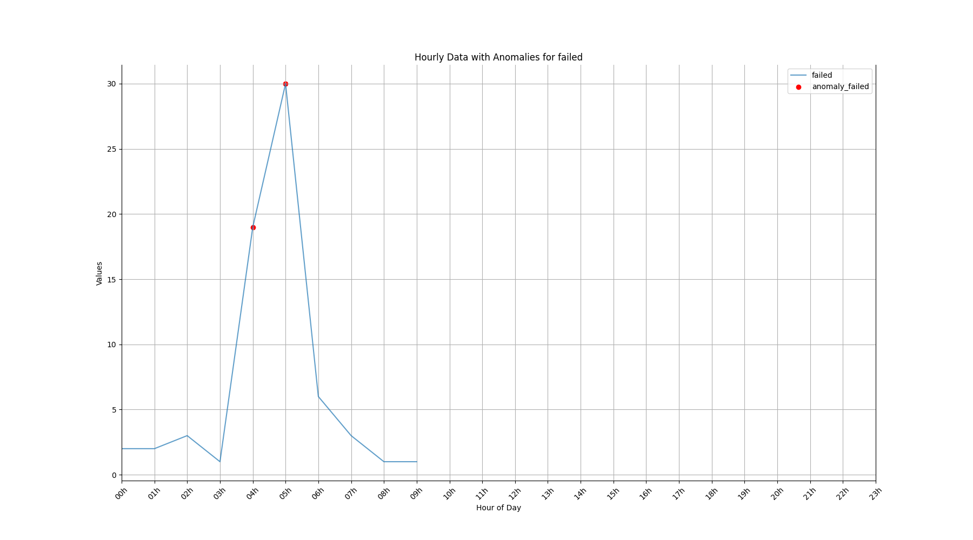
Analysis Method - FILE 1

Slide 17
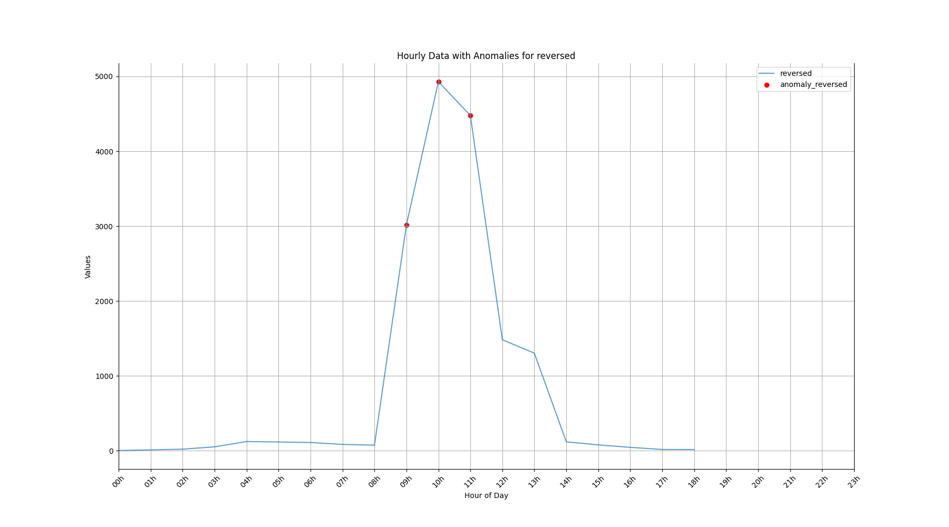
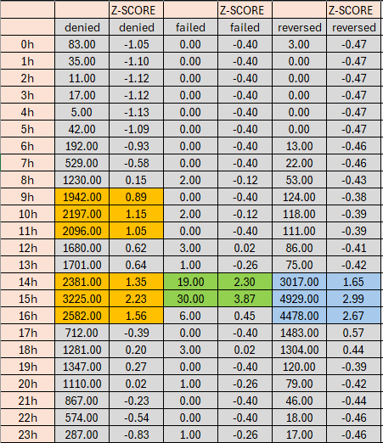
Analysis Method - FILE 1

Slide 18
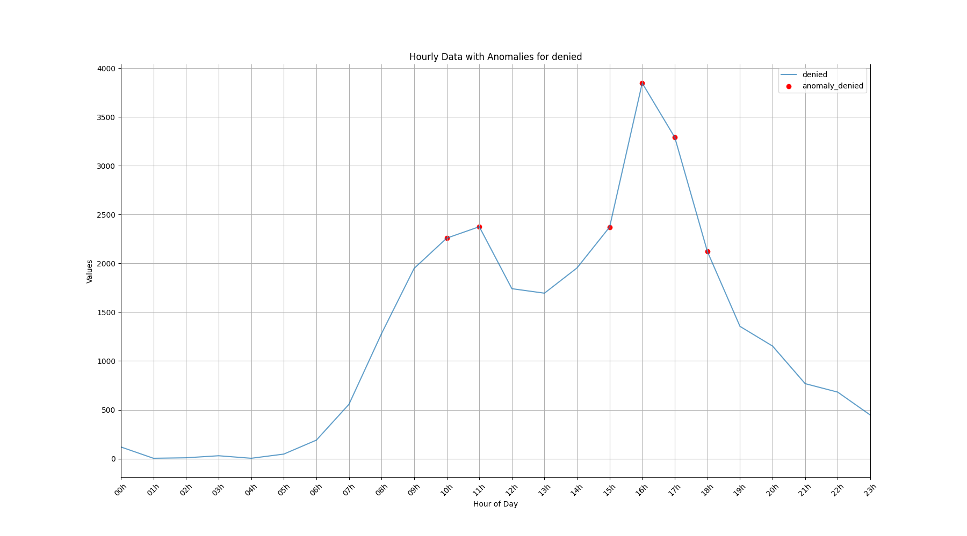
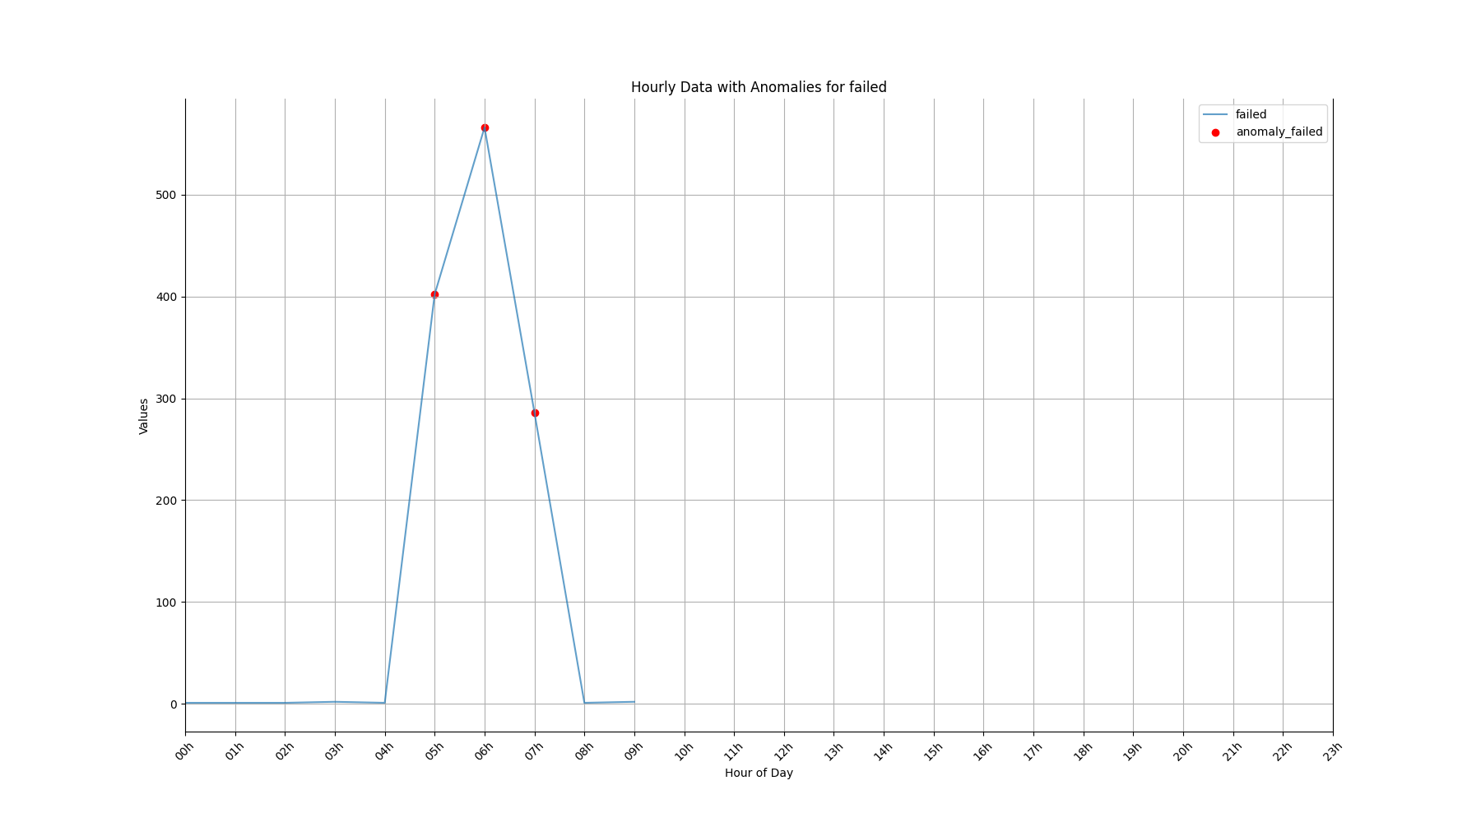
Analysis Method - FILE 2

Slide 19
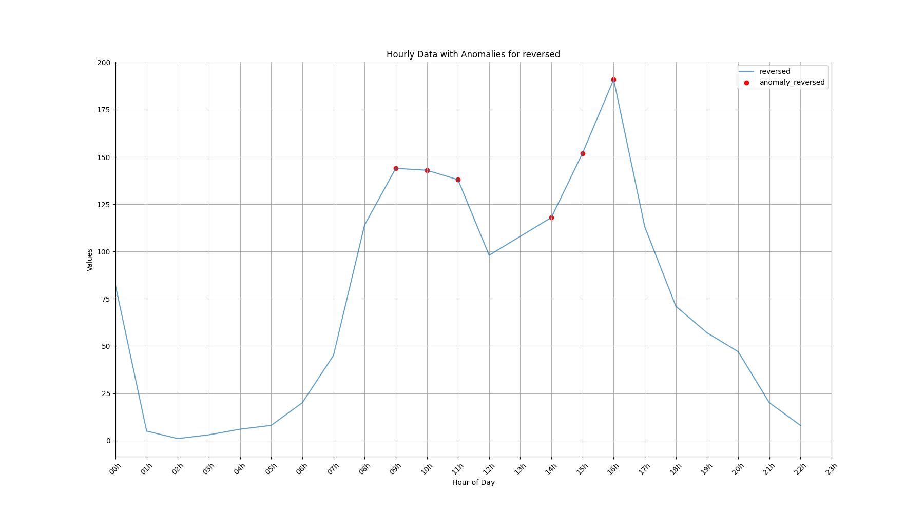
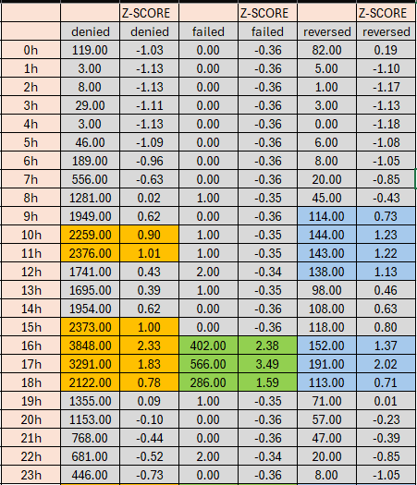
Analysis Method - FILE 2

Slide 20
Alert System
Email notification system
Inclusion of status-specific images
Detailed list of anomalous time periods

Slide 21
Prometheus and Grafana Integration
Development of "/metrics" endpoint
Challenges faced in implementation
Potential for real-time monitoring and visualization

Slide 22
Conclusion
Summary of findings from both challenges
Effectiveness of the developed systems
Potential impact on financial transaction security

Slide 23
Future Improvements
Scalable and efficient analysis approach
Risk classification system for POS
Factors: Customer profile, location, business type, transaction history

Slide 24
Q&A
- Thank you for your attention
- Any questions?

Slide 25
THANK YOU
Daniel campos França
danielcf.vix@hotmail.com

